Slide 1
Algorithm Analysis and Design Recurrence Equation (Solving Recurrence using Recursion Tree Methods) Lecture – 9 and 10

Slide 2
Overview
A recurrence is a function is defined in terms of
one or more base cases, and
itself, with smaller arguments.
Examples:

Slide 3
Overview
Many technical issues:
Floors and ceilings
[Floors and ceilings can easily be removed and don’t affect the solution to the recurrence. They are better left to a discrete math course.]
Exact vs. asymptotic functions
Boundary conditions

Slide 4
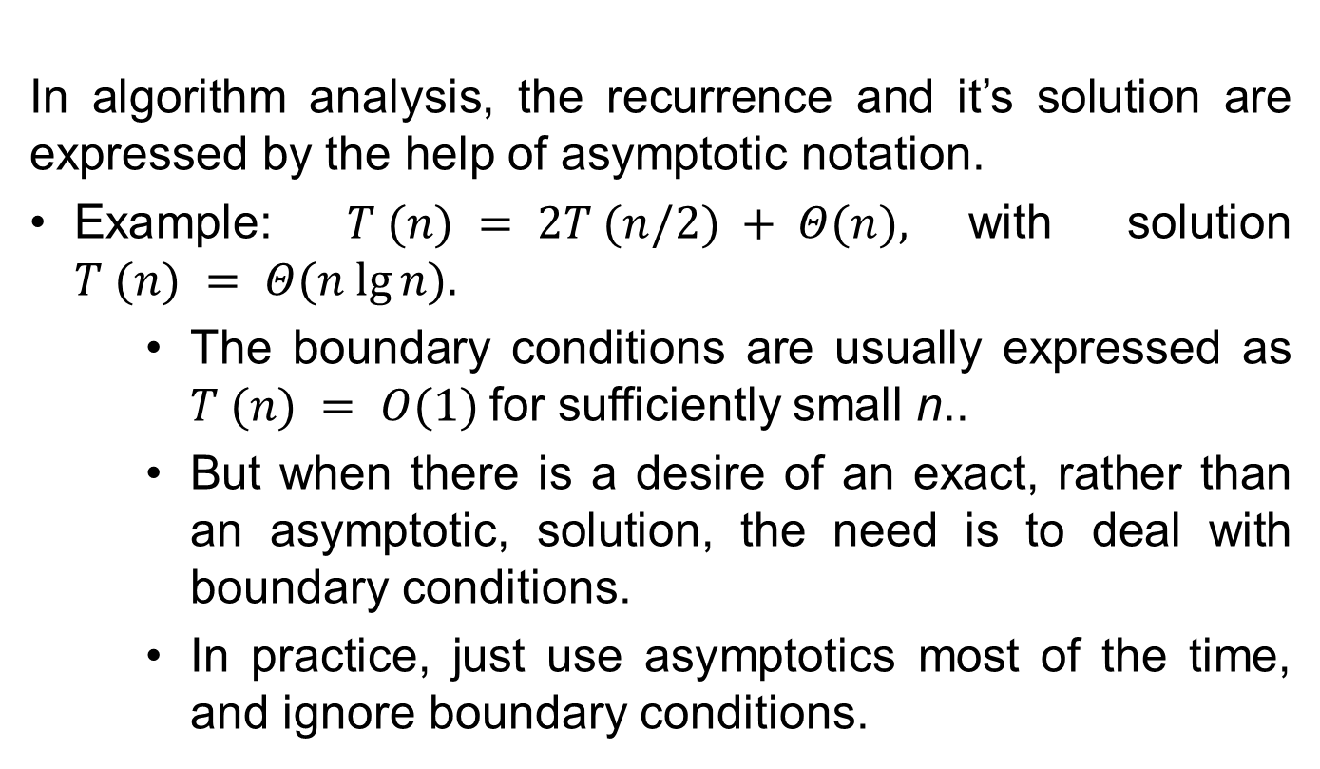
Overview
In algorithm analysis, the recurrence and it’s solution are expressed by the help of asymptotic notation.
Example: $T (n) = 2T (n/2) + Θ(n),$with solution $T (n) = Θ(n lg⁡n).$
The boundary conditions are usually expressed as $T (n) = Ο(1)$for sufficiently small n..
But when there is a desire of an exact, rather than an asymptotic, solution, the need is to deal with boundary conditions.
In practice, just use asymptotics most of the time, and ignore boundary conditions.

Slide 5
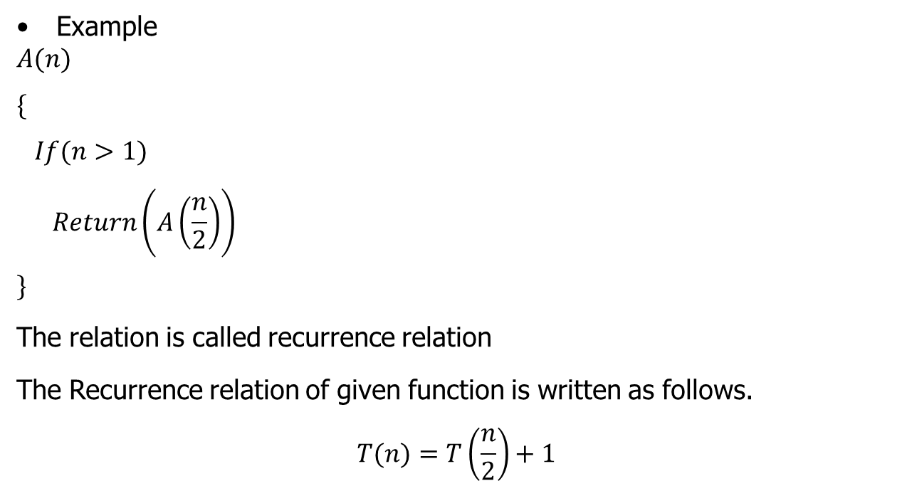
Recursive Function
Example
$$A(n)$$
$$\{$$
$$If(n>1)$$
$$Return\left(A\left(\frac{n}{2}\right)\right)$$
$$\}$$
The relation is called recurrence relation
The Recurrence relation of given function is written as follows.
$$T(n)=T\left(\frac{n}{2}\right)+1$$

Slide 6
Recursive Function
To solve the Recurrence relation the following methods are used:
Iteration method
Recursion-Tree method
Master Method
Substitution Method

Slide 7
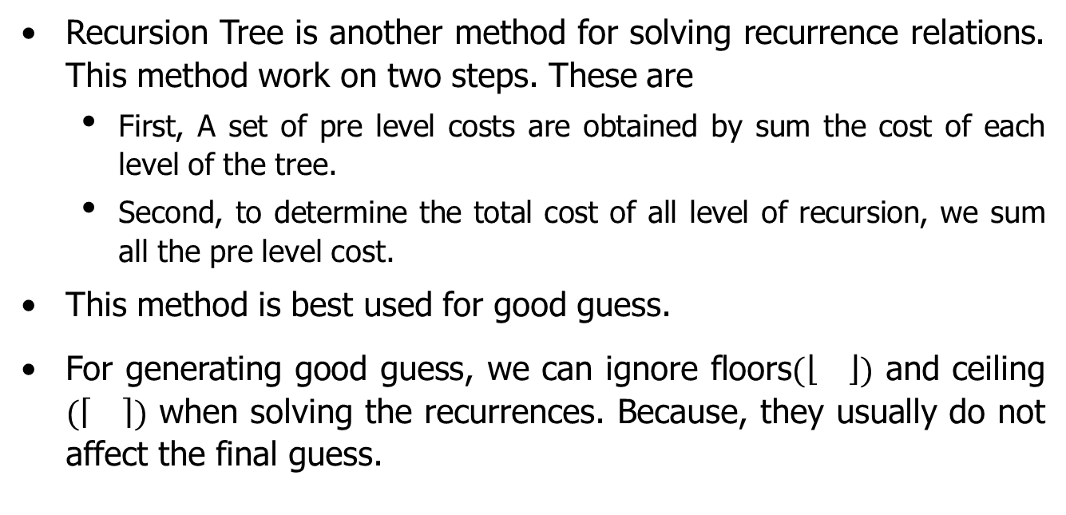
Recursion Tree Method
Recursion Tree is another method for solving recurrence relations. This method work on two steps. These are
First, A set of pre level costs are obtained by sum the cost of each level of the tree.
Second, to determine the total cost of all level of recursion, we sum all the pre level cost.
This method is best used for good guess.
For generating good guess, we can ignore floors$(\left\lfloor \right\rfloor )$ and ceiling $(\left\lceil \right\rceil )$ when solving the recurrences. Because, they usually do not affect the final guess.

Slide 8
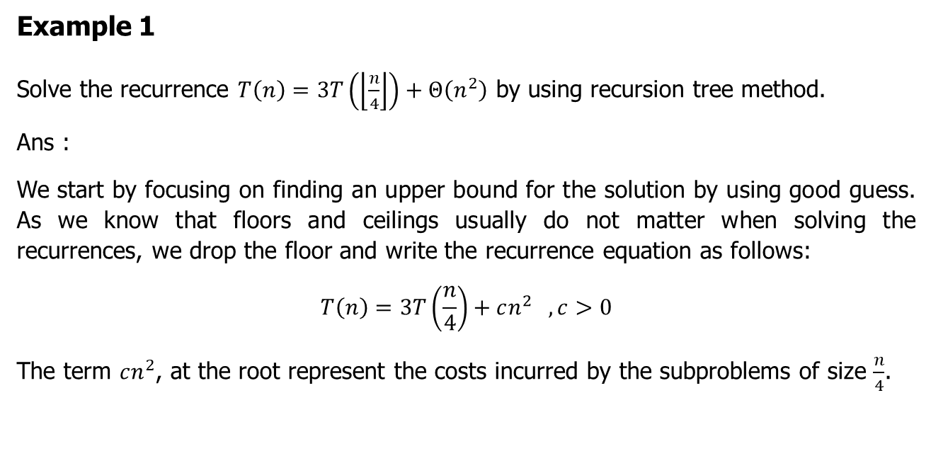
Recursion Tree Method (Example 1)
Example 1
Solve the recurrence $T\left(n\right)=3T\left(\left\lfloor \frac{n}{4}\right\rfloor \right)+Θ\left(n^{2}\right)$ by using recursion tree method.
Ans :
We start by focusing on finding an upper bound for the solution by using good guess. As we know that floors and ceilings usually do not matter when solving the recurrences, we drop the floor and write the recurrence equation as follows:
$$T\left(n\right)=3T\left(\frac{n}{4}\right)+cn^{2} , c>0$$
The term $cn^{2}$, at the root represent the costs incurred by the subproblems of size $\frac{n}{4}$.

Slide 9

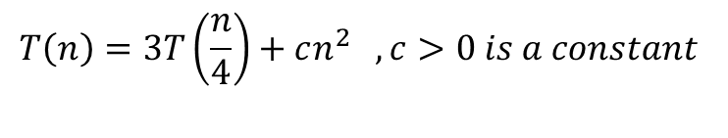
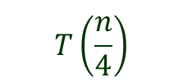
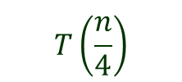
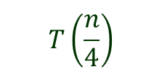
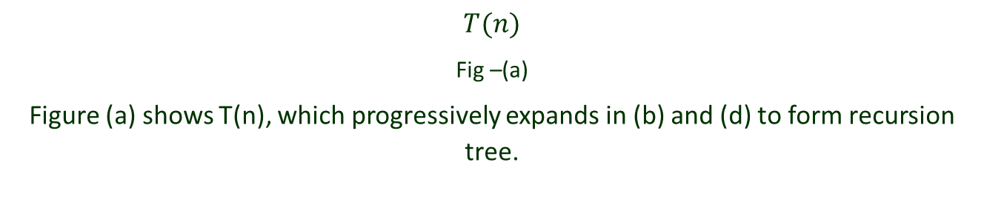
Recursion Tree Method (Example 1)
$$T\left(n\right)=3T\left(\frac{n}{4}\right)+cn^{2} , c>0 is a constant$$
$$T(n)$$
Fig –(a)
Figure (a) shows T(n), which progressively expands in (b) and (d) to form recursion tree.
$$c{\left(n\right)}^{2}$$
$$T\left(\frac{n}{4}\right)$$
$$T\left(\frac{n}{4}\right)$$
$$T\left(\frac{n}{4}\right)$$
Fig –(b)

Slide 10





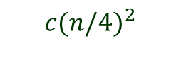




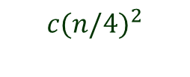


Recursion Tree Method (Example 1)
$$T\left(n\right)=3T\left(\frac{n}{4}\right)+cn^{2} , c>0 is a constant$$
$$c{\left(n\right)}^{2}$$
$$c{(n/4)}^{2}$$
$$c{(n/4)}^{2}$$
$$c{(n/4)}^{2}$$
$$T\left(\frac{n}{16}\right)$$
$$T\left(\frac{n}{16}\right)$$
$$T\left(\frac{n}{16}\right)$$
$$T\left(\frac{n}{16}\right)$$
$$T\left(\frac{n}{16}\right)$$
$$T\left(\frac{n}{16}\right)$$
$$T\left(\frac{n}{16}\right)$$
$$T\left(\frac{n}{16}\right)$$
$$T\left(\frac{n}{16}\right)$$
Fig –(c)

Slide 11



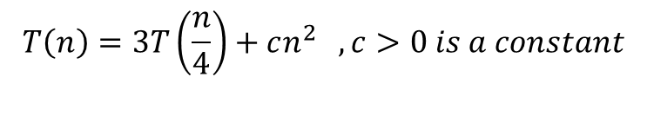

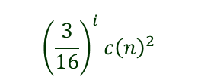




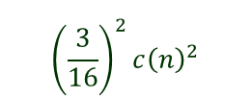










Recursion Tree Method (Example 1)
$$T\left(n\right)=3T\left(\frac{n}{4}\right)+cn^{2} , c>0 is a constant$$
$$c{\left(n\right)}^{2}$$
$$c{\left(n\right)}^{2}$$
$$\frac{3}{16}c{\left(n\right)}^{2}$$
$$c{(n/4)}^{2}$$
$$c{(n/4)}^{2}$$
$$c{(n/4)}^{2}$$
$$\log_{4}{n}$$
$${\left(\frac{3}{16}\right)}^{2}c{\left(n\right)}^{2}$$
$$c{\left(\frac{n}{16}\right)}^{2}$$
$$c{\left(\frac{n}{16}\right)}^{2}$$
$$c{\left(\frac{n}{16}\right)}^{2}$$
$$c{\left(\frac{n}{16}\right)}^{2}$$
$$c{\left(\frac{n}{16}\right)}^{2}$$
$$c{\left(\frac{n}{16}\right)}^{2}$$
$$c{\left(\frac{n}{16}\right)}^{2}$$
$$c{\left(\frac{n}{16}\right)}^{2}$$
$$c{\left(\frac{n}{16}\right)}^{2}$$
$${\left(\frac{3}{16}\right)}^{i}c{\left(n\right)}^{2}$$
$$T\left(1\right) T\left(1\right) T\left(1\right)………………………..T\left(1\right)$$
$${\left(3\right)}^{i}$$
Fig –(d)

Slide 12
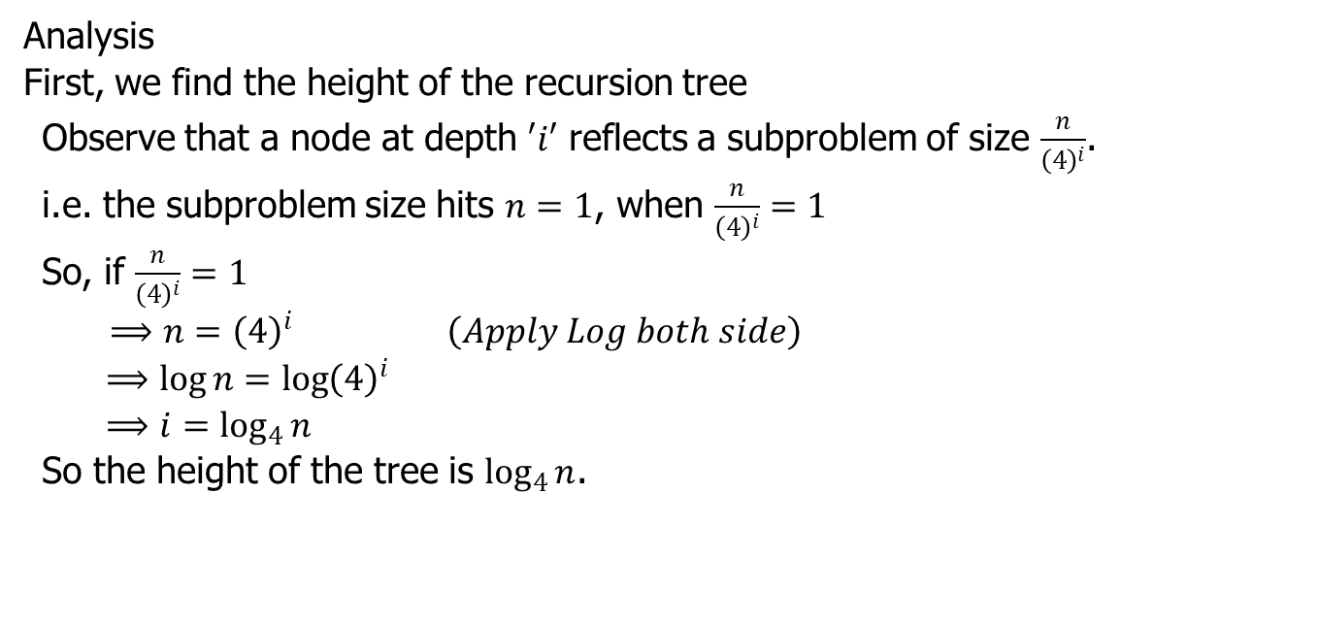
Recursion Tree Method (Example 1)
Analysis
First, we find the height of the recursion tree
Observe that a node at depth $′i′$ reflects a subproblem of size $\frac{n}{{\left(4\right)}^{i}}$.
i.e. the subproblem size hits $n=1$, when $\frac{n}{{\left(4\right)}^{i}}=1$
So, if $\frac{n}{{\left(4\right)}^{i}}=1$
$⟹n={\left(4\right)}^{i} \left(Apply Log both side\right)$
$$⟹\log{n=\log{{\left(4\right)}^{i}}}$$
$$⟹i=\log_{4}{n}$$
So the height of the tree is $\log_{4}{n}$.

Slide 13
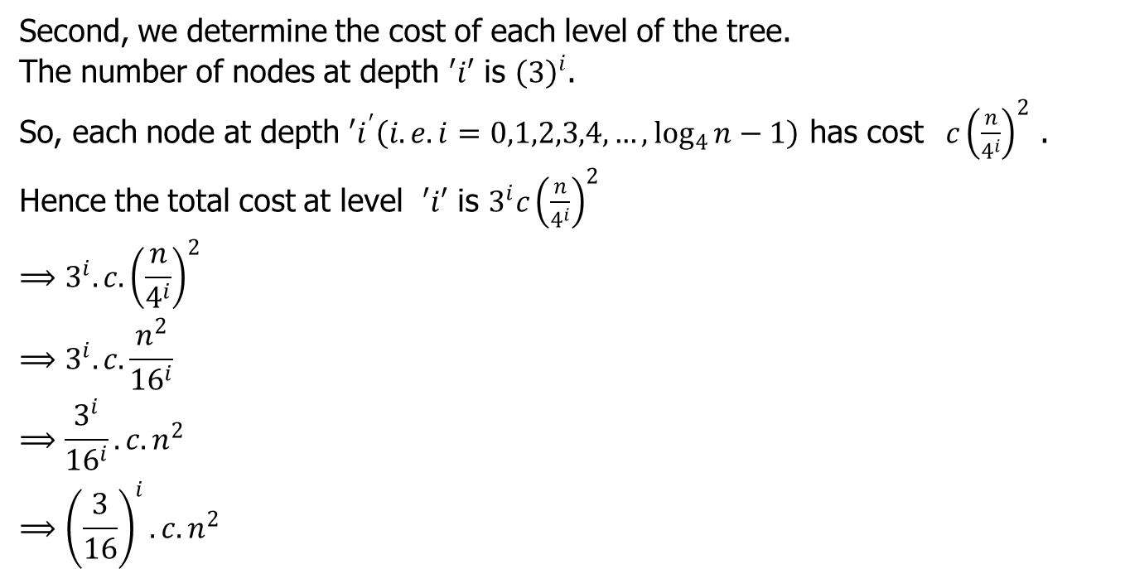
Recursion Tree Method (Example 1)
Second, we determine the cost of each level of the tree.
The number of nodes at depth $′i′$ is ${\left(3\right)}^{i}$.
So, each node at depth $′i^{′}\left(i.e. i=0,1,2,3,4,…, \log_{4}{n}−1\right)$ has cost $c{\left(\frac{n}{4^{i}}\right)}^{2}$ .
Hence the total cost at level $′i′$ is $3^{i}c{\left(\frac{n}{4^{i}}\right)}^{2}$
$$⟹3^{i}. c.{\left(\frac{n}{4^{i}}\right)}^{2}$$
$$⟹3^{i}. c.\frac{n^{2}}{{16}^{i}}$$
$$⟹\frac{3^{i}}{{16}^{i}}. c.n^{2}$$
$$⟹{\left(\frac{3}{16}\right)}^{i}.c.n^{2}$$

Slide 14
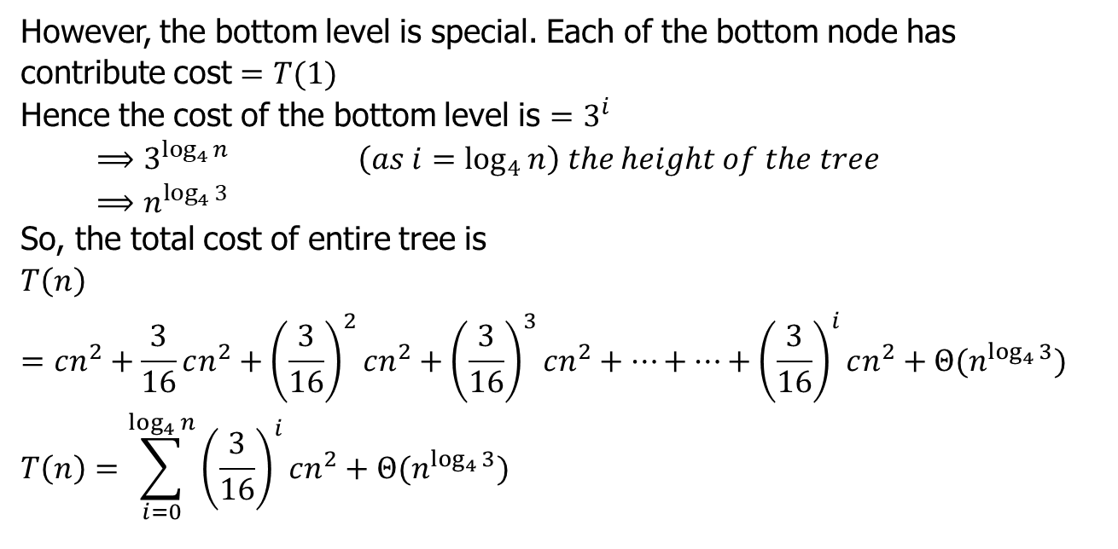
Recursion Tree Method (Example 1)
However, the bottom level is special. Each of the bottom node has contribute cost $=T(1)$
Hence the cost of the bottom level is $=3^{i}$
$$⟹3^{\log_{4}{n}} \left(as i=\log_{4}{n}\right) the height of the tree$$
$$⟹n^{\log_{4}{3}}$$
So, the total cost of entire tree is
$$T\left(n\right)=cn^{2}+\frac{3}{16}cn^{2}+{\left(\frac{3}{16}\right)}^{2}cn^{2}+{\left(\frac{3}{16}\right)}^{3}cn^{2}+…+…+{\left(\frac{3}{16}\right)}^{i}cn^{2}+Θ(n^{\log_{4}{3}})$$
$$T\left(n\right)=\sum_{i=0}^{\log_{4}{n}}{{\left(\frac{3}{16}\right)}^{i}cn^{2}}+Θ(n^{\log_{4}{3}})$$

Slide 15
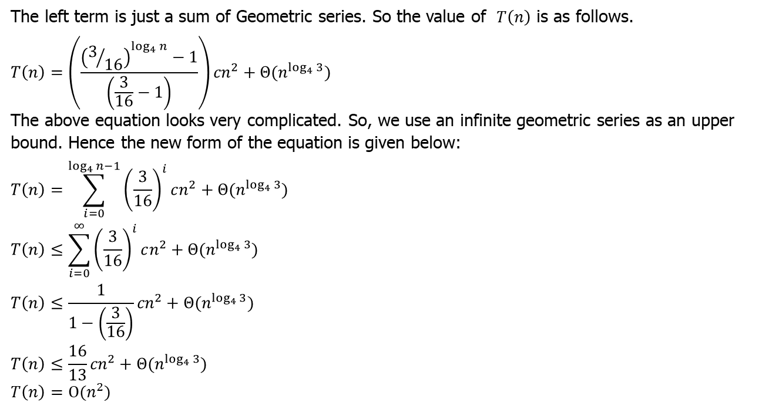
Recursion Tree Method (Example 1)
The left term is just a sum of Geometric series. So the value of $T\left(n\right)$ is as follows.
$$T\left(n\right)=\left(\frac{{\left(3/{16}\right)}^{\log_{4}{n}}−1}{\left(\frac{3}{16}−1\right)}\right){cn}^{2}+Θ(n^{\log_{4}{3}})$$
The above equation looks very complicated. So, we use an infinite geometric series as an upper bound. Hence the new form of the equation is given below:
$$T\left(n\right)=\sum_{i=0}^{\log_{4}{n−1}}{{\left(\frac{3}{16}\right)}^{i}cn^{2}}+Θ(n^{\log_{4}{3}})$$
$$T\left(n\right)≤\sum_{i=0}^{∞}{{\left(\frac{3}{16}\right)}^{i}cn^{2}}+Θ(n^{\log_{4}{3}})$$
$$T\left(n\right)≤\frac{1}{1−\left(\frac{3}{16}\right)}{cn}^{2}+Θ(n^{\log_{4}{3}})$$
$$T\left(n\right)≤\frac{16}{13}{cn}^{2}+Θ(n^{\log_{4}{3}})$$
$$T\left(n\right)=Ο(n^{2})$$

Slide 16
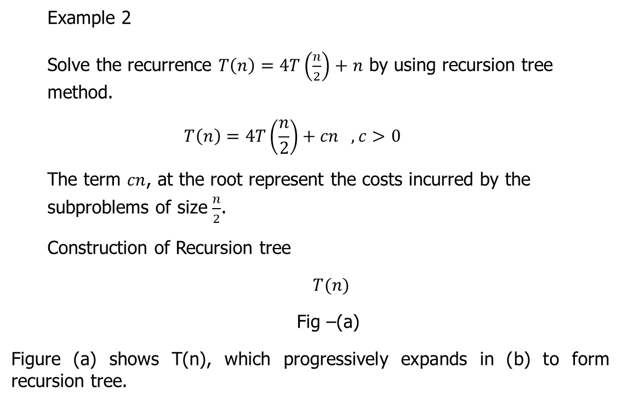
Recursion Tree Method (Example 2)
Example 2
Solve the recurrence $T\left(n\right)=4T\left(\frac{n}{2}\right)+n$ by using recursion tree method.
$$T\left(n\right)=4T\left(\frac{n}{2}\right)+cn , c>0$$
The term $cn$, at the root represent the costs incurred by the subproblems of size $\frac{n}{2}$.
Construction of Recursion tree
$T(n)$
Fig –(a)
Figure (a) shows T(n), which progressively expands in (b) to form recursion tree.

Slide 17










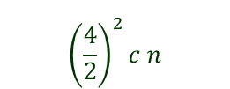


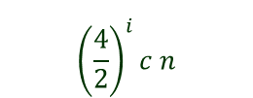






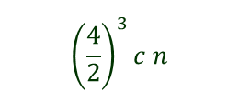









Recursion Tree Method (Example 2)
$$T\left(n\right)=4T\left(\frac{n}{2}\right)+cn , c>0$$
$$cn$$
$$cn$$
$$c\left(\frac{n}{2}\right)$$
$$\frac{4}{2}c n$$
$$c\left(\frac{n}{2}\right)$$
$$c\left(\frac{n}{2}\right)$$
$$c\left(\frac{n}{2}\right)$$
$$\log_{2}{n}$$
$${\left(\frac{4}{2}\right)}^{2}c n$$
$$T\left(\frac{n}{4}\right)$$
$$T\left(\frac{n}{4}\right)$$
$$T\left(\frac{n}{4}\right)$$
$$T\left(\frac{n}{4}\right)$$
$$T\left(\frac{n}{4}\right)$$
$$T\left(\frac{n}{4}\right)$$
$$T\left(\frac{n}{4}\right)$$
$$T\left(\frac{n}{4}\right)$$
$$T\left(\frac{n}{4}\right)$$
$$T\left(\frac{n}{4}\right)$$
$$T\left(\frac{n}{4}\right)$$
$$T\left(\frac{n}{4}\right)$$
$$T\left(\frac{n}{4}\right)$$
$$T\left(\frac{n}{4}\right)$$
$$T\left(\frac{n}{4}\right)$$
$$T\left(\frac{n}{4}\right)$$
$${\left(\frac{4}{2}\right)}^{3}c n$$
$${\left(\frac{4}{2}\right)}^{i}c n$$
$$T\left(1\right) T\left(1\right) T\left(1\right)………………………..T\left(1\right)$$
$${\left(4\right)}^{i}$$
Fig –(b)

Slide 18
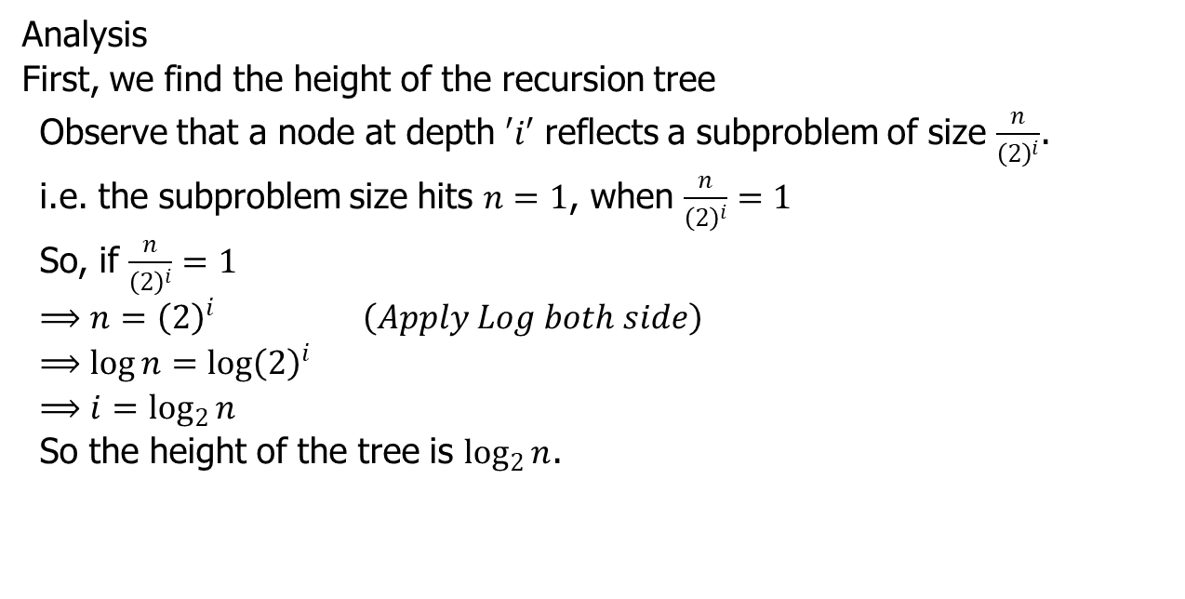
Recursion Tree Method (Example 2)
Analysis
First, we find the height of the recursion tree
Observe that a node at depth $′i′$ reflects a subproblem of size $\frac{n}{{\left(2\right)}^{i}}$.
i.e. the subproblem size hits $n=1$, when $\frac{n}{{\left(2\right)}^{i}}=1$
So, if $\frac{n}{{\left(2\right)}^{i}}=1$
$$⟹n={\left(2\right)}^{i} \left(Apply Log both side\right)$$
$$⟹\log{n=\log{{\left(2\right)}^{i}}}$$
$$⟹i=\log_{2}{n}$$
So the height of the tree is $\log_{2}{n}$.

Slide 19
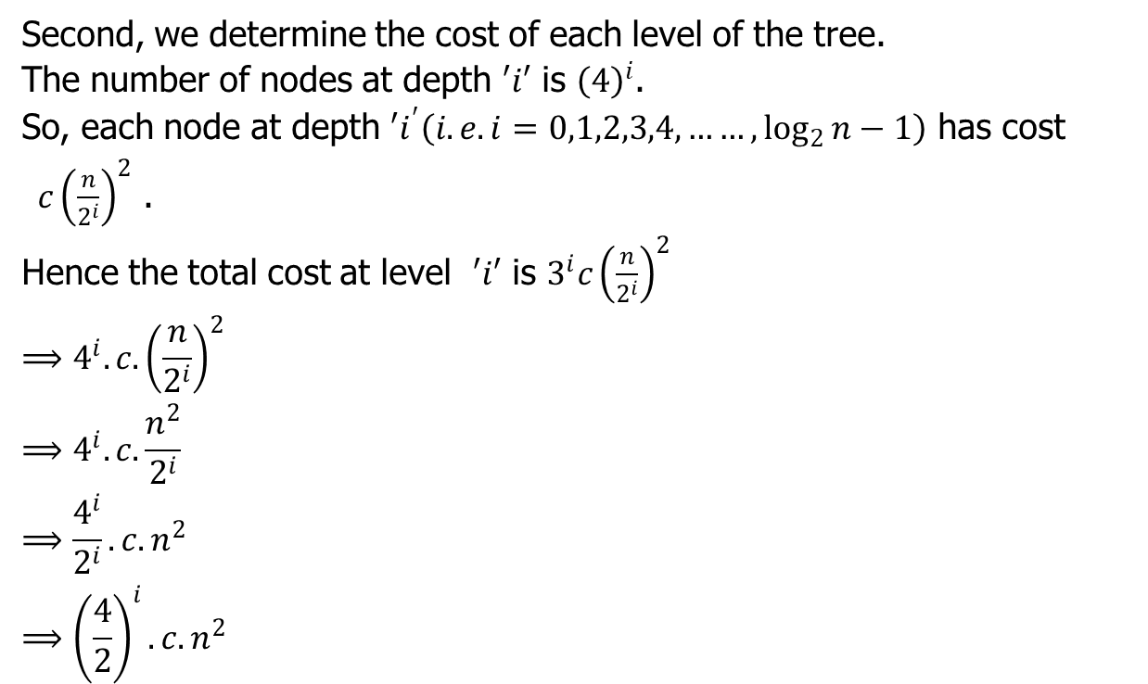
Recursion Tree Method (Example 2)
Second, we determine the cost of each level of the tree.
The number of nodes at depth $′i′$ is ${\left(4\right)}^{i}$.
So, each node at depth $′i^{′}\left(i.e. i=0,1,2,3,4,……, \log_{2}{n}−1\right)$ has cost $c{\left(\frac{n}{2^{i}}\right)}^{2}$ .
Hence the total cost at level $′i′$ is $3^{i}c{\left(\frac{n}{2^{i}}\right)}^{2}$
$$⟹4^{i}. c.{\left(\frac{n}{2^{i}}\right)}^{2}$$
$$⟹4^{i}. c.\frac{n^{2}}{2^{i}}$$
$$⟹\frac{4^{i}}{2^{i}}. c.n^{2}$$
$$⟹{\left(\frac{4}{2}\right)}^{i}.c.n^{2}$$

Slide 20
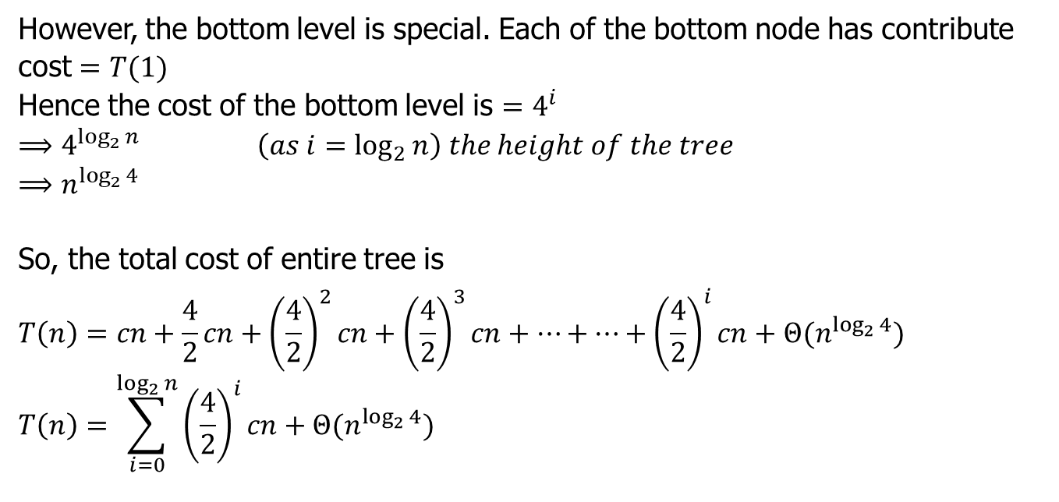
Recursion Tree Method (Example 2)
However, the bottom level is special. Each of the bottom node has contribute cost $=T(1)$
Hence the cost of the bottom level is $=4^{i}$
$$⟹4^{\log_{2}{n}} \left(as i=\log_{2}{n}\right) the height of the tree$$
$$⟹n^{\log_{2}{4}}$$
So, the total cost of entire tree is
$$T\left(n\right)=cn+\frac{4}{2}cn+{\left(\frac{4}{2}\right)}^{2}cn+{\left(\frac{4}{2}\right)}^{3}cn+…+…+{\left(\frac{4}{2}\right)}^{i}cn+Θ(n^{\log_{2}{4}})$$
$$T\left(n\right)=\sum_{i=0}^{\log_{2}{n}}{{\left(\frac{4}{2}\right)}^{i}cn}+Θ(n^{\log_{2}{4}})$$

Slide 21

Recursion Tree Method (Example 2)
The left term is just a sum of Geometric series. So the value of $T\left(n\right)$ is as follows.
$$T\left(n\right)=\left(\frac{{\left(\frac{4}{2}\right)}^{\log_{2}{n}}−1}{\left(\frac{4}{2}−1\right)}\right)cn+Θ(n^{\log_{2}{4}})$$
$$T\left(n\right)=\left(\frac{{\left(2\right)}^{\log_{2}{n}}−1}{\left(2−1\right)}\right)cn+Θ(n^{2})$$
$$\left(n\right)=\left(\frac{{\left(n\right)}^{\log_{2}{2}}−1}{\left(2−1\right)}\right)cn+{cn}^{2}$$
$$T\left(n\right)=\left(\frac{n−1}{1}\right)cn+{cn}^{2}$$
$$T\left(n\right)={cn}^{2}−cn+{cn}^{2}$$
$$T\left(n\right)={2cn}^{2}−cn$$
$$Hence,T\left(n\right)=Θ(n^{2})$$

Slide 22
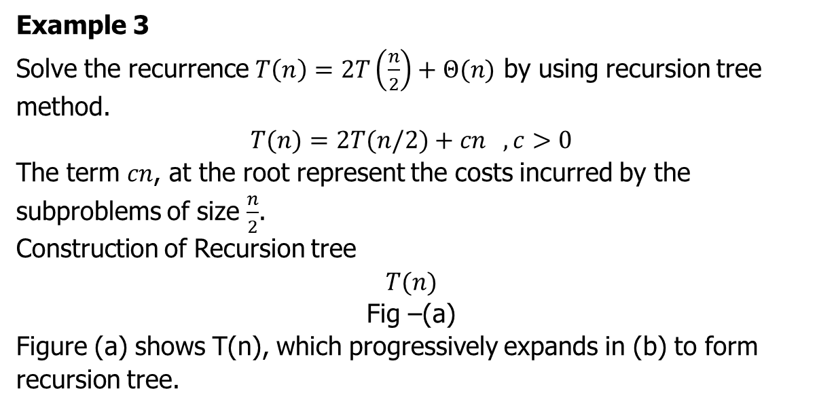
Recursion Tree Method (Example 3)
Example 3
Solve the recurrence $T\left(n\right)=2T\left(\frac{n}{2}\right)+Θ(n)$ by using recursion tree method.
$$T(n)=2T(n/2)+cn , c>0$$
The term $cn$, at the root represent the costs incurred by the subproblems of size $\frac{n}{2}$.
Construction of Recursion tree
$$T(n)$$
Fig –(a)
Figure (a) shows T(n), which progressively expands in (b) to form recursion tree.

Slide 23













Recursion Tree Method (Example 3)
$$T(n)=2T(n/2)+cn , c>0$$
$$cn$$
$$n$$
$$c \left(\frac{n}{2}\right)$$
$$c \left(\frac{n}{2}\right)$$
$$2\frac{n}{2}=n$$
$$\log_{2}{n}$$
$$T\left(\frac{n}{4}\right)$$
$$T\left(\frac{n}{4}\right)$$
$$T\left(\frac{n}{4}\right)$$
$$T\left(\frac{n}{4}\right)$$
$$2^{2}\frac{n}{2^{2}}=n$$
$$2^{i}\frac{n}{2^{i}}=n$$
$$T\left(1\right) T\left(1\right) T\left(1\right)………………………..T\left(1\right)$$
$$2^{i}$$
Fig –(b)

Slide 24
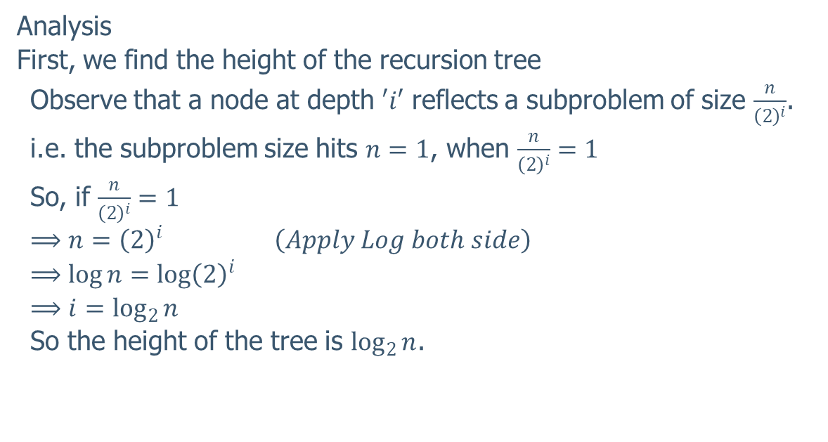
Recursion Tree Method (Example 3)
Analysis
First, we find the height of the recursion tree
Observe that a node at depth $′i′$ reflects a subproblem of size $\frac{n}{{\left(2\right)}^{i}}$.
i.e. the subproblem size hits $n=1$, when $\frac{n}{{\left(2\right)}^{i}}=1$
So, if $\frac{n}{{\left(2\right)}^{i}}=1$
$$⟹n={\left(2\right)}^{i} \left(Apply Log both side\right)$$
$$⟹\log{n=\log{{\left(2\right)}^{i}}}$$
$$⟹i=\log_{2}{n}$$
So the height of the tree is $\log_{2}{n}$.

Slide 25
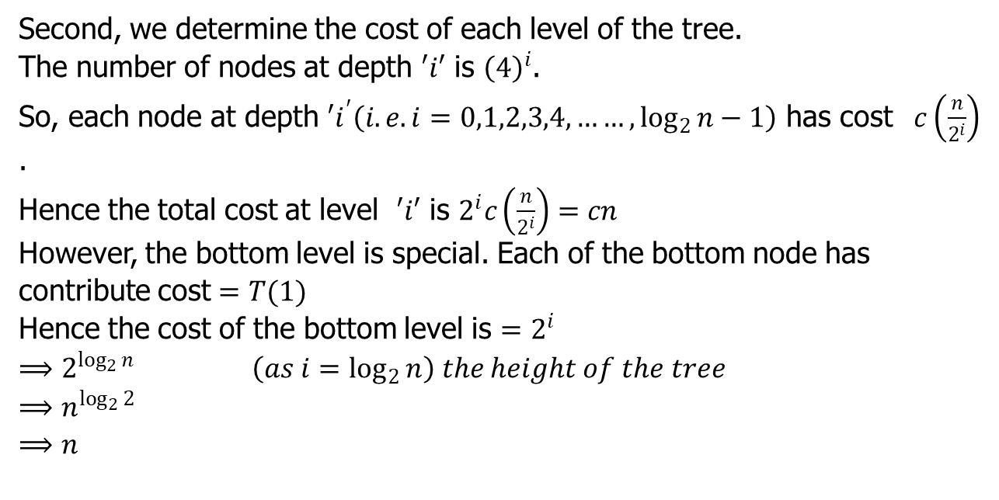
Recursion Tree Method (Example 3)
Second, we determine the cost of each level of the tree.
The number of nodes at depth $′i′$ is ${\left(4\right)}^{i}$.
So, each node at depth $′i^{′}\left(i.e. i=0,1,2,3,4,……, \log_{2}{n}−1\right)$ has cost $c\left(\frac{n}{2^{i}}\right)$ .
Hence the total cost at level $′i′$ is $2^{i}c\left(\frac{n}{2^{i}}\right)=cn$
However, the bottom level is special. Each of the bottom node has contribute cost $=T(1)$
Hence the cost of the bottom level is $=2^{i}$
$$⟹2^{\log_{2}{n}} \left(as i=\log_{2}{n}\right) the height of the tree$$
$$⟹n^{\log_{2}{2}}$$
$$⟹n$$

Slide 26

Recursion Tree Method (Example 3)
So, the total cost of entire tree is
$$T\left(n\right)=cn+cn+cn+cn+…+…+cn$$
$T\left(n\right)=cn\sum_{i=0}^{\log_{2}{n}}{1^{i} }$.
$$T\left(n\right)=cn{(log}_{2}{n+1)}$$
$$T\left(n\right)=cn\log_{2}{n+cn}$$
$$Hence,T\left(n\right)=Θ(\log_{2}{n})$$

Slide 27
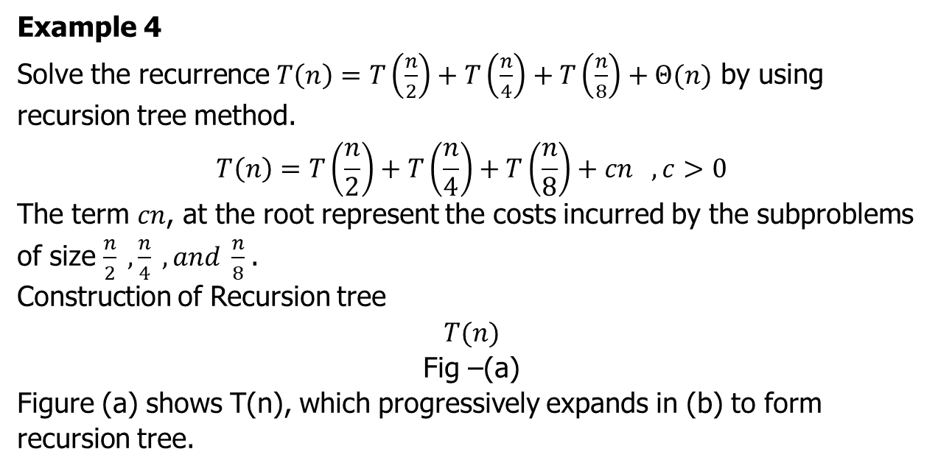
Recursion Tree Method (Example 4)
Example 4
Solve the recurrence $T\left(n\right)=T\left(\frac{n}{2}\right)+T\left(\frac{n}{4}\right)+T\left(\frac{n}{8}\right)+Θ(n)$ by using recursion tree method.
$$T\left(n\right)=T\left(\frac{n}{2}\right)+T\left(\frac{n}{4}\right)+T\left(\frac{n}{8}\right)+cn , c>0$$
The term $cn$, at the root represent the costs incurred by the subproblems of size $\frac{n}{2} ,\frac{n}{4} ,and \frac{n}{8}$.
Construction of Recursion tree
$$T(n)$$
Fig –(a)
Figure (a) shows T(n), which progressively expands in (b) to form recursion tree.

Slide 28










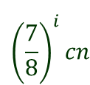





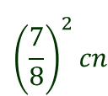




Recursion Tree Method (Example 4)
$$T\left(n\right)=T\left(\frac{n}{2}\right)+T\left(\frac{n}{4}\right)+T\left(\frac{n}{8}\right)+cn , c>0$$
$$cn$$
$$cn$$
$$c\left(\frac{n}{2}\right)$$
$$c\left(\frac{n}{4}\right)$$
$$c\left(\frac{n}{8}\right)$$
$$\frac{7}{8}cn$$
$$\log_{2}{n}$$
$$T\left(\frac{n}{2}\right)$$
$$T\left(\frac{n}{4}\right)$$
$$T\left(\frac{n}{8}\right)$$
$$T\left(\frac{n}{16}\right)$$
$$T\left(\frac{n}{32}\right)$$
$${\left(\frac{7}{8}\right)}^{2}cn$$
$$T\left(\frac{n}{8}\right)$$
$$T\left(\frac{n}{16}\right)$$
$$T\left(\frac{n}{32}\right)$$
$$T\left(\frac{n}{64}\right)$$
$${\left(\frac{7}{8}\right)}^{i}cn$$
$$T\left(1\right) T\left(1\right) T\left(1\right)………………………..T\left(1\right)$$
$$cn$$
Fig –(b)

Slide 29
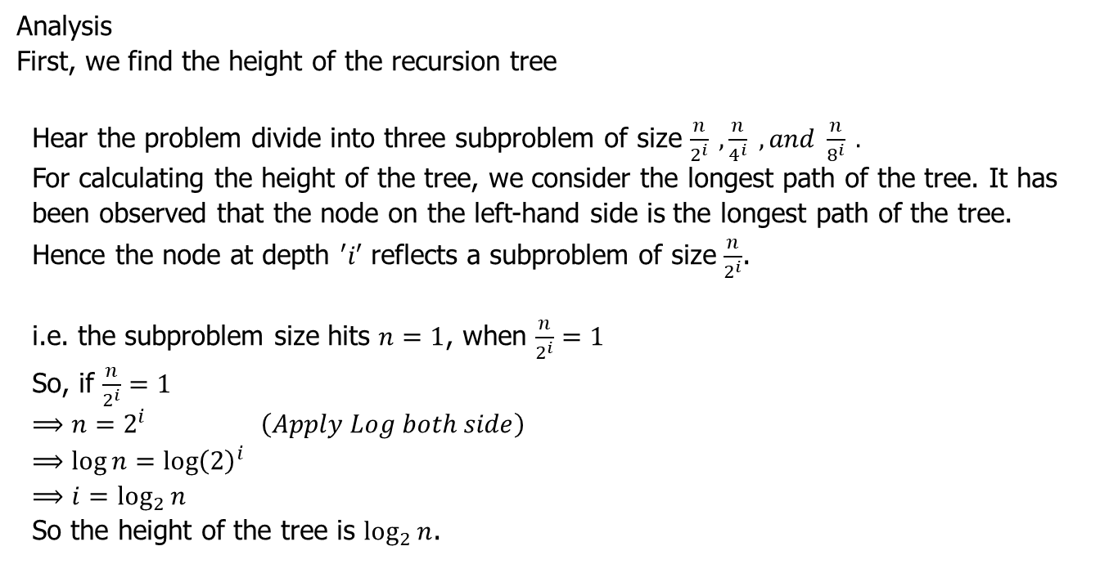
Recursion Tree Method (Example 4)
Analysis
First, we find the height of the recursion tree
Hear the problem divide into three subproblem of size $\frac{n}{2^{i}} , \frac{n}{4^{i}} , and \frac{n}{8^{i}} .$
For calculating the height of the tree, we consider the longest path of the tree. It has been observed that the node on the left-hand side is the longest path of the tree.
Hence the node at depth $′i′$ reflects a subproblem of size $\frac{n}{2^{i}}$.
i.e. the subproblem size hits $n=1$, when $\frac{n}{2^{i}}=1$
So, if $\frac{n}{2^{i}}=1$
$$⟹n=2^{i} \left(Apply Log both side\right)$$
$$⟹\log{n=\log{{\left(2\right)}^{i}}}$$
$$⟹i=\log_{2}{n}$$
So the height of the tree is $\log_{2}{n}$.

Slide 30
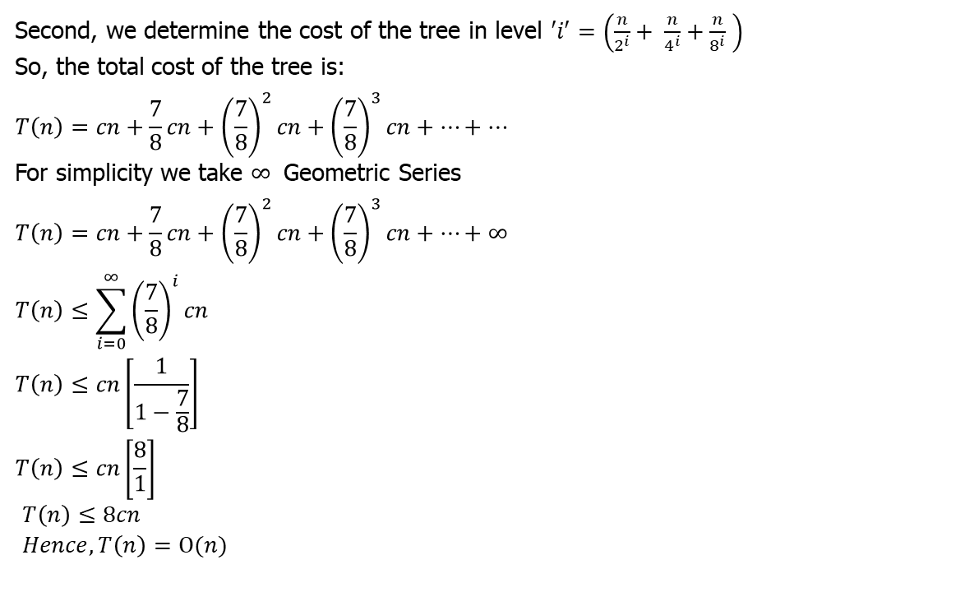
Recursion Tree Method (Example 4)
Second, we determine the cost of the tree in level $′i′$ $=\left(\frac{n}{2^{i}}+ \frac{n}{4^{i}}+\frac{n}{8^{i}} \right)$
So, the total cost of the tree is:
$$T\left(n\right)=cn+\frac{7}{8}cn+{\left(\frac{7}{8}\right)}^{2}cn+{\left(\frac{7}{8}\right)}^{3}cn+…+…$$
For simplicity we take $∞$ Geometric Series
$$T\left(n\right)=cn+\frac{7}{8}cn+{\left(\frac{7}{8}\right)}^{2}cn+{\left(\frac{7}{8}\right)}^{3}cn+…+∞$$
$$T\left(n\right)≤\sum_{i=0}^{∞}{{\left(\frac{7}{8}\right)}^{i}cn}$$
$$T\left(n\right)≤cn\left[\frac{1}{1−\frac{7}{8}}\right]$$
$$T\left(n\right)≤cn\left[\frac{8}{1}\right]$$
$T\left(n\right)≤8cn$
$Hence,T\left(n\right)=Ο(n)$

Slide 31
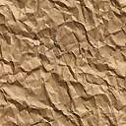
Thank U

